Slide 1
New Broker Onboarding training in Callidus Cloud for EnvisionRxPlus for 2020

Slide 2
Onboarding Reference Guide 2020
Before AGENTS begin this process make sure you have the following available.
This information will be required to upload during the Onboarding process.
COMMISSIONABLE Agents:
- A copy of your Current Errors and Omissions Insurance Policy (E&O).
New 2020 AHIP, FWA, or other qualified certificate. Will also allow you to sell for the remainder of 2019
- A PDF version of your W9 (can create in system if necessary)
A PDF version of a cancelled check or other bank documentation for the bank account (credit union etc)
that will be used in the Electronic Funds Transfer
If you’re commissionable and would like your commissions assigned to another agent under your upline you will need that agent’s NPN. (The Agent you wish to assign your commissions to must have already completed onboarding for 2020)
LOA / NON-Commissionable Agent:
- A copy of your current Errors and Omissions Insurance Policy (E&O).
- New 2020 AHIP, FWA, or other qualified certificate. Will also allow you to sell for the remainder of 2019

Slide 3
Onboarding Reference Guide 2020
Invitation Email
You will receive an email:
FROM: “envisionagentsupport@envisionrx.com
SUBJECT: EnvisionRxPlus Onboarding Invitation
This will contain your link to start to onboard for the 2020 plan year (and remainder of 2019)
Click the Login link when ready to begin Remember your DOMAIN will ALWAYS be ENRX
Please DO NOT copy and paste the User ID or Password, it creates a blank space and will not work

Slide 4
2 – Login
The User ID in your invitation email is your Login Name. (your email)
You will enter the password provided in your email invitation.
You will be asked to change your password on your first login.
The value for the DOMAIN is always enrx
Enter your credentials and press Submit.

Slide 5
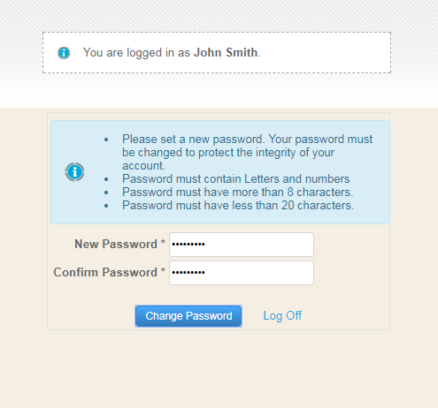
3 - Reset Password
Create a new password to continue. REMEMBER THIS PASSWORD if you need to log back in.
Between 8-20 characters must contain both letters and numbers

Slide 6
4 – Complete PDB Report Request Form
Agents enter your SSN, and check the box authorizing Callidus Cloud to request a NIPR report. When you hit submit, it will pull that information on you from NIPR
Your NPN number and NPN Lookup Results will automatically be retrieved. Then click the SUBMIT button
NEW: If the name was spelled wrong, it will bring up a message showing you the NPN not found for this
SSN/Name combination. You will see the spelling of the name that was used and did not work to retrieve the NPN
and can correct the spelling to successfully retrieve the NPN
Smith

Slide 7
5 – Open the Application
Once you log on, you will see the application link Click the blue link under the “Application” column to open your onboarding application.

Slide 8
6 - General Tab
You’ll now be taken to the main body of your onboarding application.
Many fields on your application will already be completed with the information returned from the National Insurance Producer Registry (NIPR) PDB report. PLEASE VERIFY this information is still correct. You can change any of it only on this page.
If you see an asterisk * by any fields, that means that information is required / mandatory
Please hit “SAVE” on the bottom of every page before moving to the next TAB. There are NEXT and PREVIOUS buttons on each page to help navigate through the workflow
If you omitted any required information on any of the tabs, you will see the word “incomplete” in RED on that tab. Please go back and complete. You will be unable to submit at the end if there are any “incomplete” on any tabs

Slide 9
You will begin on the General tab. Update and add information as needed, hit “SAVE” on the bottom of the page and then hit the “NEXT” button at the bottom. There are multiple fields on this page, most of them must be completed, reviewed and confirmed.
6 - General Tab continued

Slide 10
7 - Licenses Tab
Your ACTIVE licenses will appear as per the NIPR report. ONLY Check the boxes for the states you plan to ACTIVELY sell in. Please DO NOT check a state you will NOT be selling in.
At least one license must be selected. Click save and move to the next tab.

Slide 11
8 - Appointments Tab
This Tab does not require any input. It simply displays information
Go to the next Tab, Background Questionnaire

Slide 12
9 - Background Questionnaire Tab
Answer all background questions, providing explanations for each “Yes” answer in the box that will appear.

Slide 13
10 – Background Agreement Tab
There may be several different type of agreements, depending on onboarding assignment. Click each agreement button to open them.
Agreements MUST be signed using your full name as given on the General tab. If you are not using the proper signature the system will show you the proper way to sign in red below the box. Click the SIGN Button after typing in your signature

Slide 14
11 – Insurance Tab
Provide all required E&O insurance information and upload a copy of your policy certificate.
Upload Button

Slide 15
12. Banking Information
Banking Tab is designed for your banking situation. Who will receive your base commissions?
If Commissionable, You can ONLY select one of the options : Yourself, your Agency, or to Assign your commissions to another Agent who is already appointed and in your same hierarchy.
IF YOU ARE LOA /NON-COMMISSIONABLE, You should NOT have this BANKING tab. If you do, STOP - call your Agency or Envision as you may have the wrong workflow.

Slide 16
12. Banking Information
Who will receive your base commissions?
1.) You – using your SSN for tax purposes (See example below)
2.) Your Owned Agency, using your Tax ID/FEIN for tax purposes
3.) You wish to assign commissions to another Agent within your immediate hierarchy. You will need to know the NPN number of this agent (The Agent you wish to assign your commissions to must have already completed onboarding for 2020)
Fields related to your choice of Payee will appear. Complete these fields and upload a voided check or banking document
IF YOU ARE LOA /NON-COMMISSIONABLE, You should NOT have this BANKING tab. If you do, STOP - call your Agency or Envision as you may have the wrong workflow.
Upload Button

Slide 17
12. Banking Information continued
Who will receive your base commissions?
1.) You - if you get your own commissions, you will need your SSN.
2.) Your Owned Agency, using your Tax ID/FEIN for tax purposes (see example below)
3.) You wish to assign commissions to another Agent within your up line. You will need to know their NPN
number (The Agent you wish to assign your commissions to must have already completed onboarding for 2020)
Fields related to your choice of Payee will appear. Complete these fields and upload a voided check or banking document
IF YOU ARE LOA /NON-COMMISSIONABLE, You should NOT have this BANKING tab. If you do, STOP - call your Agency or Envision as you may have the wrong workflow.
Upload Button

Slide 18
12. Banking Information continued
Who will receive your base commissions?
1.) You – using your SSN for tax purposes (See example below)
2.) Your Owned Agency, using your Tax ID/FEIN for tax purposes
3.) You wish to assign commissions to another Agent within your immediate hierarchy. You will need to know the NPN number of this agent (The Agent you wish to assign your commissions to must have already completed onboarding for 2020) See example below. You will not complete banking information or W9.
Fields related to your choice of Payee will appear. Complete these fields and upload a voided check or banking document if applicable.
IF YOU ARE LOA /NON-COMMISSIONABLE, You should NOT have this BANKING tab. If you do, STOP - call your Agency or Envision as you may have the wrong workflow.

Slide 19
13 – W9 tab
If you have a completed W9 in PDF format, upload it using the Upload button
If paying yourself as an individual the W9 will have your SSN
If paying yourself through your Agency the W9 will have your FEIN (THIS IS NOT YOUR UPLINE)
If assigning commissions to another Agent, you will NOT be asked for banking information W9
IF YOU ARE LOA /NON-COMMISSIONABLE, You should NOT have a BANKING tab.
If you do, STOP - call your Agency or Envision as you may have the wrong workflow
If you do not have a W9 completed, click the Open a W9 Document button to open an interactive W9 PDF.
You do not have to print and sign it for it to be used
Upload Button

Slide 20
14 - Education Tab
Select the Education tab at the top in your workflow
This will take you to another site called LITMOS for the training course and then the test
If you get a log in screen for Litmos this is an error. At no point should you have to register for a Litmos account or free trial.
Do not sign up! Contact envisionagentsupport@envisionrx.com
Hit Continue or the X out of the Hello box to start your training
Complete the Litmos training module(s) provided
and take a short test.

Slide 21
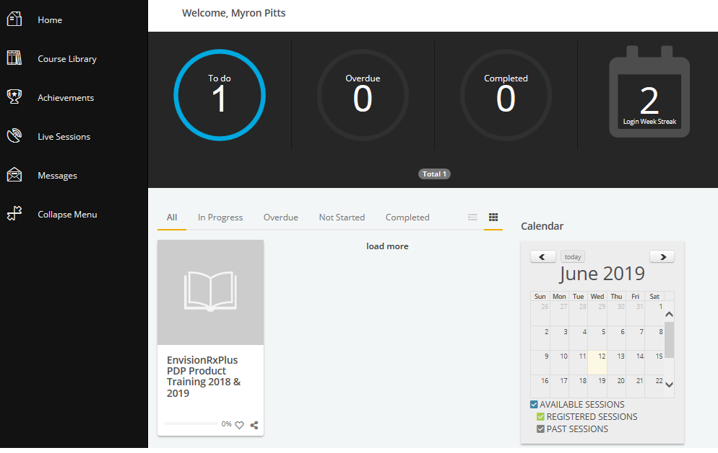
14 - Education Tab
Click either on the image of the book or the words: EnvisionRxPlus PDP Product Training 2020, to start the training.
Training has to be completed before you can take the test. It won’t allow you to just skip to the test
Must pass the test within 3 attempts with a 85% score
If not able to pass in 3 attempts, you have to wait 6 months to try again.
When completed, scroll UP to the Workflow Tab list to continue the onboarding. Certifications tab is next
AGAIN: If you get a log in screen for Litmos this
is an error.
Contact envisionagentsupport@envisionrx.com
2020
2019

Slide 22
15 – Certifications Tab
Select the radio button corresponding to the certifications you have; this will cause the relevant fields to display.
Using the BLUE UP ARROW, Upload your new 2020 certification, enter a completion date.
Upload button

Slide 23
15 – Certifications Tab continued
If you have your compliance certificates outside of AHIP, from another qualified Vendor, the separate FWA and AHIP documents need to be uploaded. Using the BLUE UP ARROWS, Upload your new 2020 certification, enter a completion date
Upload buttons

Slide 24
16 - Agreements Tab
Click on the Agreement buttons to open them.
NEW: Check the attestation box next to the 3 agreements after you signed them
Agreements MUST be signed using your full name as given on the General tab. If you are not using the proper signature the system will show you the proper way to sign in red below the box. Click the Accept box and SIGN Button after typing in your signature

Slide 25
17 – Submit Tab
Once all required Onboarding information is entered, go to the last tab called Submit. Check the attestation box that you finished everything in all the tabs, then click the BLUE SUBMIT BUTTON
If you see any RED incomplete notes on any of the tabs, you must go back and complete before you would be able to hit submit
You will see a text box open up from the top letting you know it was successfully submitted

Slide 26
18 - Email Notifications
You will receive emails notifying you if your application is approved, rejected, or requires more Information.
After approved and on-boarded, you will receive email notification. This email gives you your 2020 writing number and your login
credentials to the Callidus Cloud Broker Portal ICM system.
Broker Portal is where you will be able to follow your enrollments and see your commission statements if applicable.
For commission statements or to see enrollment status: go to Callidus Cloud ICM:
https://eic.callidusinsurance.net/ICM/
Your user name is your 6 digit writing number starting with 0…..
Password is whatever you set it up as. Forgot Password button is there.
Statements link and Customer Application Search is on the left side to select.
For application status using envisionrxplus.com
Go to www.envisionrxplus.com
Go to the Broker tab (will have to enter your zip code and hit continue)
Scroll down a little bit and on the Right you will see check application status and more: Portal sign in
If NEW to Envision, to log in you will need to register, the link is below the user ID sign in.

Slide 27
18 – Example of Email Notification
Dear Eleanor Rigby,
You have completed your onboarding with EnvisionRxPlus. You are now able to write PDP business for the remainder of 2019 and all of 2020.
Your New Producer Number/Writing Code is 001234
You have access to the Callidus Cloud Broker Compensation Portal, where you currently find the following information:
Your Commission Statements
Your Enrollments/Application Status Detail
Your Personal Demographic data that you entered/verified during Onboarding
Your current user name and password will remain the same.
Login Link: https://eic.callidusinsurance.net/ICM
Username: 001234 (current writing number)
Password: The password you set up. There is a reset password link if needed.
If you need to reset your password, the password must be at least eight characters long and contain at least one: capital letter, lower case letter, number, and special character.
You will also have access to the Envision Broker Portal, where you will enter your enrollments. There you will find the following information:
Your Enrollments/Application Status Detail
Login link: https://broker.envisionrxplus.com/
Being new to Envision, you must register for access.
*** DO NOT copy and paste your username or password when logging in. This WILL prevent you from logging in successfully ***
Thank you,

